Slide 1


Littleton
Wastewater Collection System
Asset Management
March 23, 2020

Slide 2
What is ASSET MANAGEMENT?
The goal of an Asset Management Program is to manage system assets to meet the designated level of service in the most cost-effective manner. There are several key benefits of asset management, including:
  Enumerate the state of existing infrastructure
  Assist with rate setting based on sound information
  Ensure transparency with system customers
  Provide an organized approach to system operation and asset management

Slide 3
Wastewater Collection System
This Asset Management Program (AMP) was developed for the Littleton Wastewater Collection System (LWWCS). The wastewater collection system assets that are included in this plan are as follows:
  Collection and transmission mains
    181,600 LF Gravity Mains
    13,700 LF Pressure Mains
  Manholes
    819
A loan with forgiveness to develop an Asset Management Program for the pumps stations and wastewater treatment plant has been secured and work for that project will begin soon.

Slide 4
Wastewater Collection System

Slide 5
Collection System Asset Valuation
Asset Category | Asset Group | 2019 Estimated Replacement Cost ($)
Distribution | Mains | $25,300,000
 | Manholes | $3,100,000
Total |  | $28,400,000

Slide 6
Evaluation Process
Data Collection – Inventory Development
  Existing and collected mapping
  Field observation – manhole inspections
  Data was entered into GIS in the database managed by CAI with
  Information on each of the assets is included in the GIS map data
  DPW staff entered manhole inspection data
  DPW staff can access and edit the map online

Slide 7
Evaluation Process
Data Analysis
  Because most of the wastewater system assets are below ground, the condition of these assets was primarily based on:
    Type of material
    Estimated installation date of the item
    Repair history

Slide 8
Evaluation Process
Ongoing Management
  The reliability of conclusions made in this AMP is directly related to the quality and accuracy of input data used to develop the asset inventory.
  The inventory should be updated as new data becomes available.
  New projects should provide plans to DPW for entry in the inventory.

Slide 9
Condition Assessment
Pipe Age
  As pipe ages, it can crack or collapse causing blockage
Pipe Slope
  Insufficient slope can cause solids to settle, creating a blockage
Additional information should be gathered as part of planning phase analysis through video inspections of mains.

Slide 10
Probability of Failure
Pipe Age
  Existing Records
  Pipe Material
Manhole Material
Asset Type | Asset Component |  | Probability of Failure
Collection | Sewer | VC (Vitrified Clay) | Moderate
 |  | AC (Asbestos Cement) | Minor
 |  | RCP (Reinforced Concrete) | Minor
 |  | PVC | Low
 |  | Mixed | Moderate
 |  | Unknown | Minor
 | Manholes | Brick | High
 |  | Block | Moderate
 |  | Poured | Minor
 |  | Precast | Low
 |  | Unknown | Moderate

Slide 11
Consequence of Failure
Factors to consider when identifying the areas with the highest consequence of failure:
  Location within the system
  The amount of wastewater being conveyed, and
  Proximity to environmental resources.
Asset Type | Consequence of Failure
Trunkline/Interceptor | Major
State highways | Moderate
Areas connecting state highways to trunklines | Moderate
Town Streets collecting other Streets | Minor
Dead End Mains | Negligible
Consequence of Failure | Pipe Length (ft) | % of Total
Major | 12,300 | 3.6
Moderate | 35,400 | 18.2
Minor | 79,215 | 40.7
Negligible | 67,940 | 34.9

Slide 12
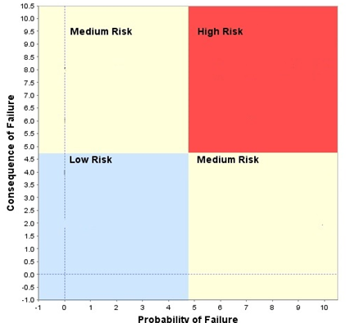
Risk
Risk = Probability of Failure x Consequence of Failure
  High risk assets: Assets that have both a high consequence of failure and a high probability of failure
  Medium risk assets: Assets that have either a high consequence of failure or a high probability of failure
  Low risk assets have both a low consequence of failure and a low probability of failure.

Slide 13
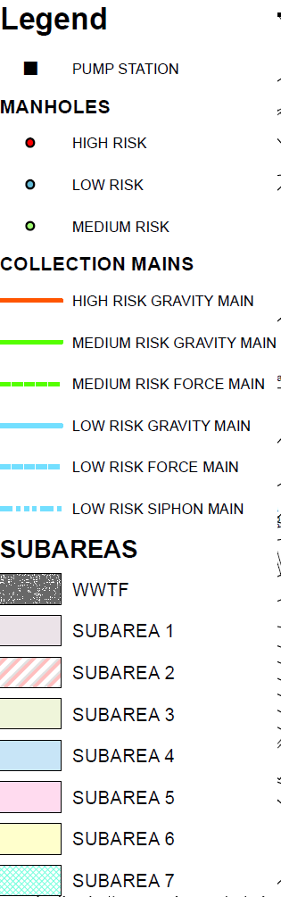
High Risk Areas

Slide 14
Level of Service Goals
There are several benefits to establishing the desired level of service, including:
  Identifying asset management strategies to meet target level of service
  Keeping customers informed on the performance of the LWWCS and conformance standards
  Identifying the costs attributed to certain levels of service

Slide 15
Level of Service Goals

Slide 16
Identified Projects

Slide 17
Project Costs and Recommended Timeframe
Project Timeframe | PROJECT DESCRIPTION
1-3 years | Project 1 - Subarea 2
 | Install 12,940 LF of New 8-inch Sewer Main with Manholes and Services | $2,160,980
 | Install 3,475 LF of New 12-inch Sewer Main with Manholes and Services | $667,200
 | Miscellaneous Work, Restoration, Traffic Control and Cleanup | $1,052,120
 | Contingency, Engineering, Legal, Administrative and Permit Fees | $1,828,900
 | Total Project Cost | $5,709,200
3-6 years | Project 2 – Cottage Street
 | Install 9,600 LF of New 8-inch Sewer Main with Manholes and Services | $1,725,200
 | Miscellaneous Work, Restoration, Traffic Control and Cleanup | $1,380,160
 | Contingency, Engineering, Legal, Administrative and Permit Fees | $1,450,890
 | Total Project Cost | $4,556,250
6-10 years | Project 3 – Subarea 6
 | Install 1,140 LF of New 8-inch Sewer Main with Manholes and Services | $210,770
 | Install 2,960 LF of New 12-inch Sewer Main with Manholes and Services | $584,350
 | Miscellaneous Work, Restoration, Traffic Control and Cleanup | $629,080
 | Contingency, Engineering, Legal, Administrative and Permit Fees | $848,300
 | Total Project Cost | $2,272,500

Slide 18
Funding Strategy
Sewer Budget
Category | 2015 | 2016 | 2017 | 2018 | % Change
Existing Debt | $6,143 | $7,523 | $18,475 | $47,367 | 671%
Operation & Maintenance | $97,115 | $15,347 | $76,465 | $130,770 | 35%
Contracted Services | $448,376 | $463,639 | $463,639 | $485,654 | 8%
Capital Reserve | $500 | $500 | $500 | $500 | 0%
Other Expenses | $161,896 | $174,884 | $177,757 | $189,032 | 17%
Total Budget | $714,030 | $736,836 | $736,836 | $853,323 | 20%
Current Sewer Rates
Term | Cost per Cubic Feet (CF) | Replacement/ Reserve Fund Fee
2019 July - December | $0.053816 | 9%
2019 January – July | $0.057280 | 9%
2018 July – December | $0.050423 | 9%
 | Current Rate | Local funding | State CWSRF Program | RD 20% Grant Loan Program
Estimated Usage Rate | $0.053816 | $0.09485 | $0.08013 | $0.07614
Estimated Reserve Fund | 9% | 9% | 9% | 9%
Estimated Annual Bill | $610/year | $1,070/year | $908/year | $856/year
Increase from Current Rate | - | +$460/year | +$298/year | +$246/year

Slide 19
SUMMARY
In the next 10 years, nearly $14M needs to be invested in wastewater collection system
This requires rate increases of 40-80% depending on the funding source
The current rate for the average single-family home is $610/yr using approximately 5,000 gallons per month term
The average rate for wastewater in the State of New Hampshire is $678/yr
Additional investigation during preliminary engineering for these projects is required to refine cost estimates and identify opportunities for project savings. These cost estimates are based on full replacement of manholes and mains.
PROJECT DESCRIPTION | Estimated Total Project Cost (2019 Dollars)
Project 1 – Subarea 2
Total Project Cost | $5,709,200
Project 2 – Cottage Street
Total Project Cost | $4,556,250
Project 3 – Subarea 6
Total Project Cost | $2,272,500
TOTAL | $12,537,950

Slide 20
Littleton
Subarea 5 Construction Budget Review

Slide 21
Current Budget
Construction
 | Original Bid Price | $ 2,220,752.00
 | Change orders | $ (391,849.65)
 | Current Contract Price | $ 1,828,902.35
Engineering
 | Preliminary Engineering | $ 18,743.00 | Reduced by $30,000 RD Grant
 | Final Design | $ 85,000.00
 | Construction Basic | $ 93,340.00 | Fixed Fee
 | Construction RPR | $ 122,000.00 | Time and Expense To Date
 | Construction Record Documents | $ 10,000.00 | Time and Expense Estimated
 | Asset Management | $ 41,600.00
 | Total | $ 370,683.00
Total Estimated Engineering and Construction Cost
 | Construction | $ 1,828,902.35
 | Engineering | $ 370,683.00
 | Total Cost | $ 2,199,585.35
Remaining Budget
 | Bond Authority | $ 2,340,000.00
 | Total Engineering and Construction to date | $(2,199,585.35)
 | Total Remaining | $ 140,414.65

Slide 22
Mill Street
Mill Street
 | Estimated Construction Cost | $ 193,329.00 | Estimate from JA McDonald
 | 5% Contingency on Construction Cost | $ 9,666.45
 | Additional Engineering - RPR | $ 63,800.00 | Remaining budget from above (time and expense)
 | Additional Engineering - Record Documents | $ 3,000.00 | Estimated
 | Total Cost for Mill Street | $ 269,795.45
Total Cost completing Mill Street
 | Total Current Construction | $ 2,199,585.35
 | Total Mill Street | $ 269,795.45
 | Granite Curb for Mill Street | $ 17,250.00
 | Total | $ 2,486,630.80
Local Share to Complete Mill Street
 | Total Cost | $ 2,486,630.80
 | Bond/Loan Amount | $(2,340,000.00)
 | Local Share | $ 146,630.80
Notes:
1. The Mill Street cost estimate does not include retaining wall work
2. The work on Mill Street would have to be completed as a change order under the current contract.
3. Selectboard approved local share of $132,300 in December 2018

Slide 23
Mill Street
Draft Change Order to allow JA McDonald to complete work prepared and approved by DES
Construction schedule is weather dependent
Goal completion date of May 15 if weather allows
Motion for agreement to proceed with construction as described on Mill Street?

Slide 24
Littleton
Wastewater Treatment Plant

Slide 25
Wastewater Treatment Plant Asset Management
Phase 2 Asset Management
  Due to Littleton’s size, the wastewater collection system is eligible for another $30,000 in loan forgiveness for asset management
  A bond was approved in 2019 for the CWSRF loan
  Will include an inventory and evaluation of the Wastewater Treatment Plant and pump station assets

Slide 26
Wastewater Treatment Plant - Preliminary Engineering Report (PER)
Evaluate alternatives to address issues identified during the asset management work and provide recommendations for process improvements.
  Process improvements to be evaluated currently include:
    Improvements at the headworks
    Addition of a primary clarifier
      Grit and solids removal, removal of oil and grease, reduce BOD and TSS loading
    Septage receiving upgrades
    Replacement of the screw pumps
    Moving the centrifuge
    Treatment alternatives for metals
Identify 20-year capital improvements and rate alternatives to fund improvements
Engineering Study Budget $72,400
Determination of grant funding in the amount of $30,000 pending
Motion to proceed with the Preliminary Engineering Report?

Slide 27
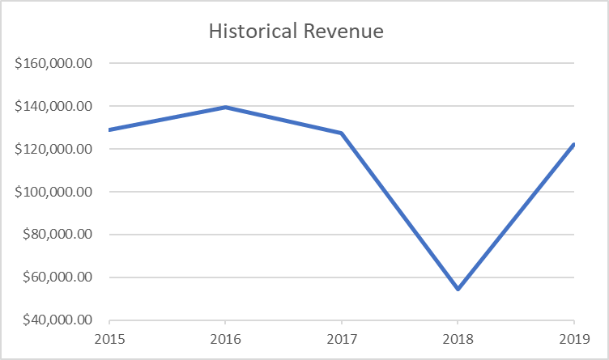
Wastewater Treatment Plant – Septage Receiving
Wastewater Treatment Plant Septage Receiving Improvements
  Historical Septage Receiving Revenue
    $122,000-$139,000 (excluding 2018)

Slide 28
Wastewater Treatment Plant – Septage Receiving
Wastewater Treatment Plant Septage Receiving Improvements
  Increased capacity will result in increased revenue with pre-treatment
  Preliminary Pre-treatment unit costs
    Pre-treatment unit
      $130,000-$375,00 depending on unit and options selected
    Building to house pre-treatment unit recommended due to freezing issues in winter months
      $115,000 depending on selected unit requirements
    Plumbing and Electrical
      $25,000 estimated
    Relocation of office trailer
      $10,000 estimated
    Total Estimated Cost: $280,000-$520,000

